Slide 1
Chapter 2
Getting started with java

Slide 2
Objective
Know the Java Features and its Runtime Environment
Get familiar with new releases in Java
Understand the basic structure of a Java program
Get into the details about JDK Installation
Know about the various constituents of JDK and its development environments.

Slide 3
Introduction
Java is a programming language invented by James Gosling and others in 1994.
originally named Oak ,was developed as a part of the Green project at the Sun Company.

Slide 4
Java Essentials
A high level language
Java Bytecode – intermediate code
Java Virtual Machine (JVM) – interpreter for bytecode

Slide 5

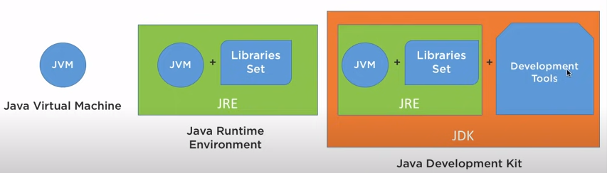
JVM / JRE / JDK

Slide 6
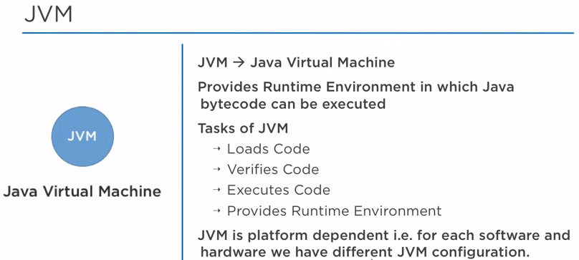
JVM

Slide 7
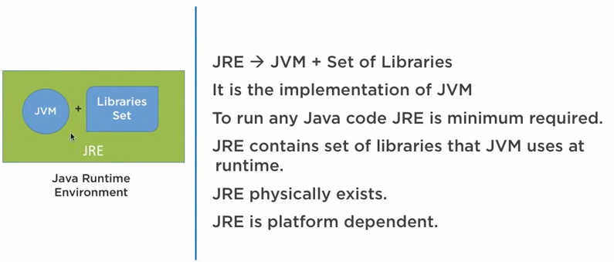
JRE

Slide 8
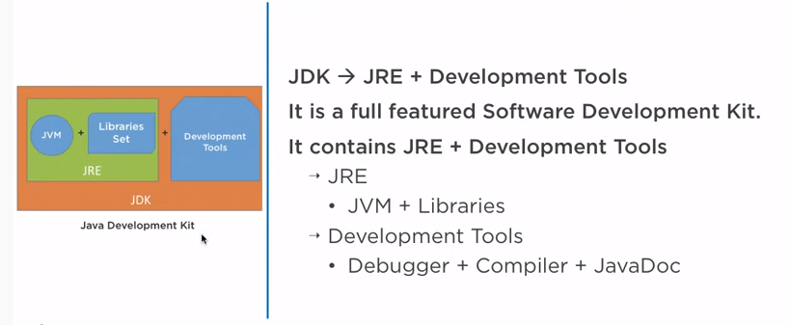
JDK

Slide 9
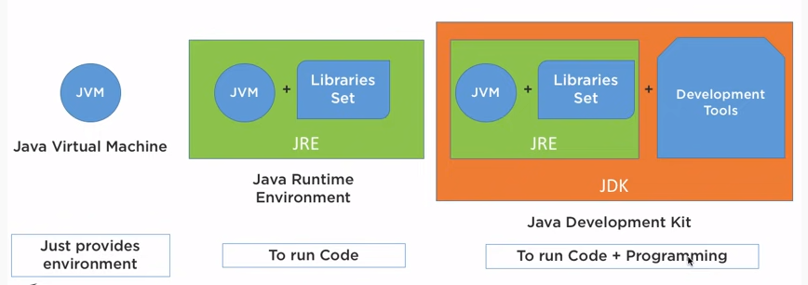

Slide 10
Java Runtime
Java Runtime Environment includes JVM, class libraries and other supporting files.
JAVA SOURCE CODE
Compilation
JAVA BYTE CODE
Interpretation
JAVA VIRTUAL MACHINE
(JVM)

Slide 11
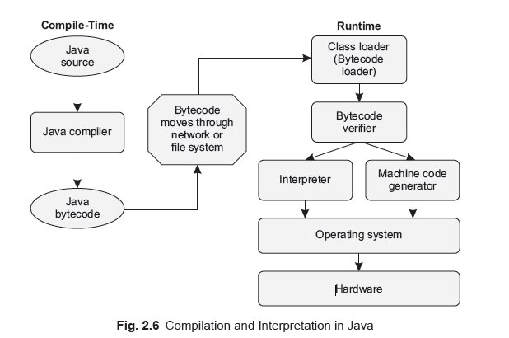
Java Approach

Slide 12
Java Features
Platform Independence
Object oriented
Compiled and interpreted
Robust
Security
  Strictly typed language
  Lack of pointers
  Garbage collection
  Strict compile time checking
  Sandbox security

Slide 13
Java Features
Multithreaded
Dynamic binding
Performance
Networking
No pointers
No global variables
Automatic Garbage collection

Slide 14
Java 5 New features
Autoboxing and unboxing
Enhanced For loop
Metadata
Variable arguments
Static import
Graphics enhancemnets
Generics
Enum
StringBuilder class

Slide 15
Java 6 New features
Enhancements in Collections API
Console class
Jar and Zip enhacements
Enhancements to Network Interface
Enhancements in Java web start and plug in

Slide 16
Java 7 New Features
String in switch…case Statement
Unicode 6.0.0 Support
Binary Literals and Numeric Literals (with Underscores)
Automatic Resource Management
Improved Exception Handling
nio 2.0 (Non-blocking I/O)—New File System API

Slide 17
Java 7 features (contd.)
Fork and Join for parallel processing
Supporting Dynamism using invokedynamic to let JVM resolve type info at runtime
No need of Diamond Operator <> on right side of the expression
Swing Enhancements
Java FX 2.2.3 provides the new GUI toolkit for creating rich cross-platform user interfaces

Slide 18
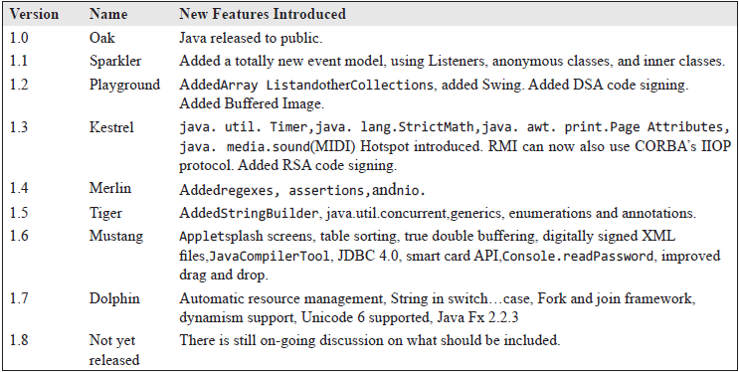
Comparison of Java Version

Slide 19
Differences between C++ and Java
Multiple Inheritance not allowed
  Multi level inheritance is enforced, which makes the design clearer. Multiple inheritance among classes is not supported in java. Interfaces are used for supporting multiple inheritance
Common parent
  All classes are single-rooted. The class Object is the parent of all the classes in java.
Packages
  The concept of packages is used, i.e. a large, hierarchical namespace is provided. This prevents naming ambiguities in libraries.
In-source documentation
  In-source code documentation comments are provided. Documentation keywords are provided for e.g.: @author, @version e.t.c.
All code inside class
  All code resides inside a class. Global data declaration outside the class is not allowed. However, static data within classes is supported.

Slide 20
Differences between C++ and Java
Operator overloading
  Operator overloading is not supported in java but there are few operator which are already overloaded by java for e.g. +. Programmers do not have the option of overloading operators.
Explicit boolean type
  boolean is an explicit type, different from int. Only two boolean literals are provided i.e. true and false. These cannot be compared with integers 0 and 1 as used in some other languages.
Array length accessible
  All array objects in java have a length variable associated with them to determine the length of the array.

Slide 21
Differences between C++ and Java
goto
  Instead of goto, break and continue are supported.
Pointers
  There are no pointers in java.
null pointers reasonably caught
  Null pointers are caught by a NullPointerException.
Memory management
  Explicit destructor is not needed. The use of garbage collection prevents memory leaks and referencing freed memory.
Automatic variable initialization
  Variables are automatically initialized except local variables.
Runtime container bounds checks
  The bounds of containers (arrays, strings, etc.) are checked at runtime and an IndexOutOfBoundsException is thrown if necessary.

Slide 22
Differences between C++ and Java
All definitions are well defined
  Methods and fields carry explicitly one of the access modifiers.
Sizes of the integer types defined
  The sizes of the integer type’s byte, short, int and long are defined to be 1, 2, 4 and 8 bytes.
Unicode provided
  Unicode represents character in most of the languages for e.g. Japanese, Latin e.t.c.
String class
  An explicit predefined String class is provided along with StringBuffer and new StringBuilder class.

Slide 23
Differences between C++ and Java
Extended utility class libraries: package java.util
  Supported among others: Enumeration (an Iterator interface), Hashtable, Vector.
Multithreading support with synchronization
  Java supports Multithreading with synchronization among them.
Default access specifier added
  By default, in java all variables, methods and classes have default privileges which are different from private access specifier. Private is the default access specifier in C++.

Slide 24
JVM and JRE
JVM is a part of JRE
Java Runtime Environment
Operating Systems (Windows, Unix, etc.)
Hardware (Intel, Motorola, Alpha, etc.)

Slide 25
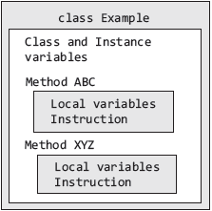
Program Structure
A Java Application consists of a collection of classes.
A class is a template containing methods and variables.

Slide 26
First Java Program
/* Call this file “Example.java”.*/
class Example {
//your program starts execution with a call to //main()
public static void main(String args[ ]){
System.out.println(“This is a simple Java program”);
}
}

Slide 27
Executing Java Programs
Entering the source code: text editor like notepad or any IDE
Saving the source code:
  Select File | Save As from the notepad menu.
  In the ‘File name’ field, type “Example.java” within the double quotes
  In the ‘Save as type’ field select All Files (*.*).
  Click enter to save the file.
Compiling & running the source
  type cmd at the run prompt
  move to the folder that contains the saved Example.java file
  compile the program using javac,
  C:\javaeg\>javac Example.java

Slide 28
Executing Java Programs
Compilation creates a file called Example.class
This class contains bytecode which is interpreted by JVM.
To execute the program type the following command at the dos prompt:
  C:\javaeg\>java Example
The output of the program is shown below:
  This is a simple Java program

Slide 29
Why save as Example.java?
The name of the .class file will match exactly with the name of the source file.
That is why it is a good idea to give the Java source files the same name as that of the class they contain.
Java is case-sensitive.
So example and Example are two different class names.

Slide 30
Your Turn
Let us revise the concepts
  What is platform independence?
  What is the relation between JVM and JRE?
  Differences between C++ and Java?
  Why the source file is named after the class name in java?

Slide 31
Installation of Java
Download the JDK installer
Run the JDK installer.
Update PATH Environment variables.
Test the installation – run javac and java on command prompt

Slide 32
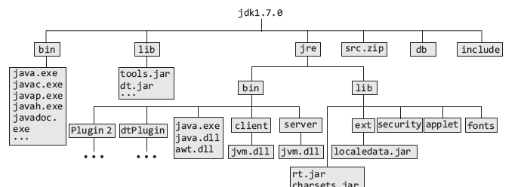
Installed Directory structure

Slide 33
Installed Directory Structure
src.zip file contains all the core class binaries, and is used by JDK in this form.
include\ directory contains a set of C and C++ header files for interacting with C and C++.
lib\ directory contains non-core classes like dt.jar and tools.jar used by tools and utilities in JDK.
bin\ The bin directory contains the binary executables for Java. For example, Java Compiler (Java), Java Interpreter (Java) , rmicompiler, (rmic) etc.
jre\ is the root directory for the Java runtime environment.
db\ contains java database

Slide 34
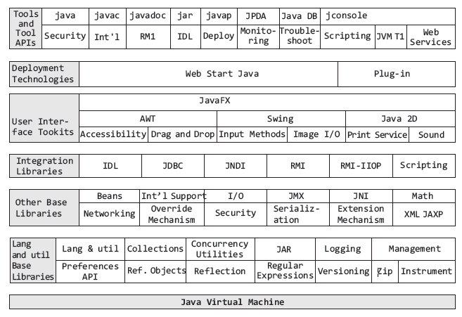
Exploring the JDK

Slide 35
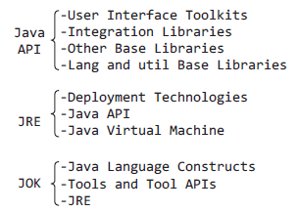
Exploring the JDK
JDK=JRE + JAVA API

Slide 36
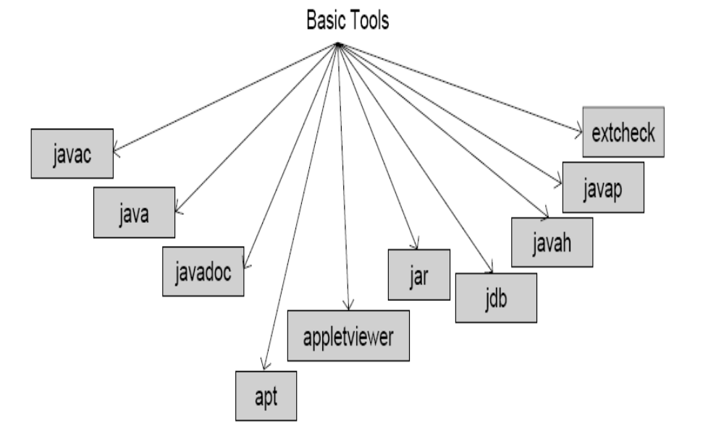
Tools in JDK
Basic Tools in Java

Slide 37
IDE
tools specifically designed for writing Java code.
tools offer a GUI environment to compile and debug your Javaprogram easily from the editor environment, as well as browse through your classes etc.
Popular IDE’s
  Eclipse
  Netbeans
  Kawa
  JCreator

Slide 38
Summary
Java is an object-oriented language.
Java is designed to be platform Independent, so it can run on multiple platforms.
Every Java program consists of one or more classes.
A class is nothing but a template for creating objects.
In Java, code reside inside a class.
Java bytecode executes on a special type of microprocessor.
As, there was not a hardware implementation of this microprocessor available when Java was first released, the complete processor architecture was emulated by a software known as virtual machine. (popularly known as JVM)

